Slide 1
DSP
Lecture 2
Digital System and Signal Transmission
By Yonghao Wang

Slide 2
Review of Binary System
In Digital Communication and DSP area all values / signals are represented by binary system
The Decimal System
  847 = 8*100 + 4*10 + 7
  847 = 8 * 102 + 4 * 101 + 7 * 100
The Binary System
  1011 = 1 * 2³ + 0 * 2² + 1 * 2¹ + 1 * 2⁰
  1011= 1 * 8 + 0 * 4 + 1 * 2 + 1 = 11
LSB and MSB
  Least significant bit
  Most significant bit
by Y.Wang 2007

Slide 3
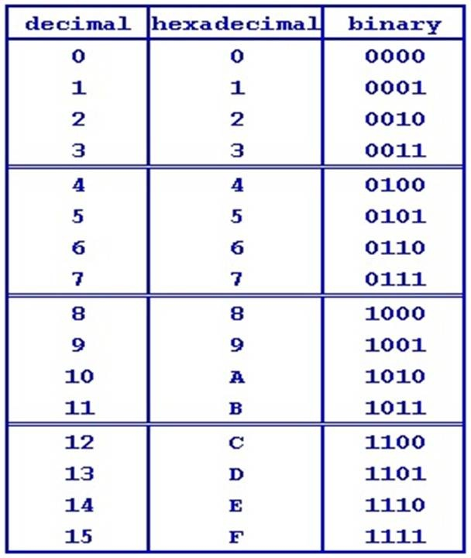
Hexadecimal
In programming Hexadecimal number sometimes start with prefix 0x, so FF is noted as 0xFF
by Y.Wang 2016

Slide 4
Bit, Byte, and Word
Bit
  A digit in the binary numeral system (0 or 1).
Byte
  A byte is a collection of bits, almost always eight bits. (1111.0000)
Transfer Rate: Bps (decimal unit)
  Bits per second, 1Kbps = 1000 bits per second.
Capacity Unit: Bytes (binary unit)
  1Giga = 1024 Mega; 1 Mega = 1024 Kilo;
  1 Kilo = 1024 (bytes).
  New standard from 2012: Gibi, Kibi, Mebi, Tebi …
by Y.Wang 2007

Slide 5
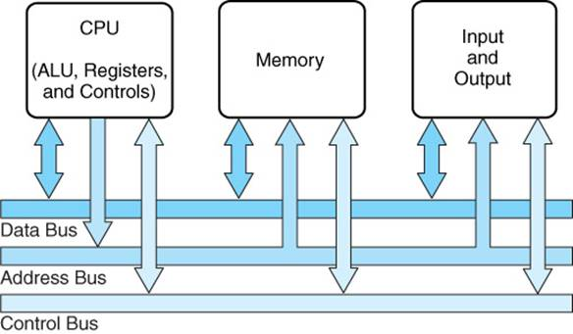
Inside Computer
by Y.Wang 2016
Notes:
What are the three common components of computer system?

Slide 6
Bus System
Digital audio and music are represented as binary stream (0,1 s).
Transmitting binary stream inside hardware devices requires bus system.
The characteristics of signal put certain requirements when you design or chose those bus systems, for example:
  The digital audio transmission.
  The characteristics of Sampling frequency, sound quality (bit resolution).
by Y.Wang 2016

Slide 7
Bus System in Computer system
CPU
  Central Processing Unit
  Control Unit to execute instructions
  ALU to carry arithmetic calculation
  Small working memory
Memory
  Address / RAM /ROM
  Capacity in Bytes
I/O devices
  Sound card, Network Interface Card (NIC), USB etc.
by Y.Wang 2007
Notes:
Northbridge and Southbridge are bus controller we mentioned in last slide.

Slide 8
Three Bus Architecture
An address bus: this determines the location in memory that the processor will read data from or write data to.
A data bus: this contains the contents that have been read from the memory location or are to be written into the memory location.
A control bus: this manages the information flow between components indicating whether the operation is a read or a write and ensuring that the operation happens at the right time.
by Y.Wang 2007
Notes:
http://www-mdp.eng.cam.ac.uk/web/library/enginfo/mdp_micro/lecture1/lecture1-3-1.html

Slide 9
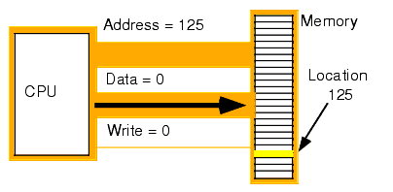
Example of addressing
Address bus number : 0111 1101
Write operation‬
by Y.Wang 2007
Notes:
http://www.plantation-productions.com/Webster/www.artofasm.com/Linux/HTML/SystemOrganizationa2.html

Slide 10
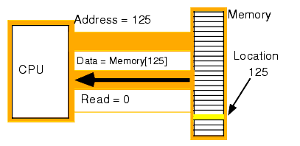
Addressing Read example
Address bus number : 0111 1101
Read operation‬
by Y.Wang 2007
Notes:
http://www.plantation-productions.com/Webster/www.artofasm.com/Linux/HTML/SystemOrganizationa2.html

Slide 11
Question
An old 8086 CPU has 20 address lines (pins). How many memory space can this CPU access to in theory? (Hints: 20 address lines represent 20 bits long binary.)
  2 ^ 20 = 1,048,576 = 1024 K = 1Mega
How about 32-bit computer, and 64-bit computer?
  32bit -> 4Giga
  64bit -> 16 Exa = 16*1024 Peta = 16*1024*1024 Tera
by Y.Wang 2007
Notes:
2 ^ 20 (pin numbers) = 1048576 = 1024 K = 1M;
386 machine 32 bit address = 2 ^ 32 = 4G memory (its more than that because it has A2-A31) (A0A1 as mode selection);

Slide 12
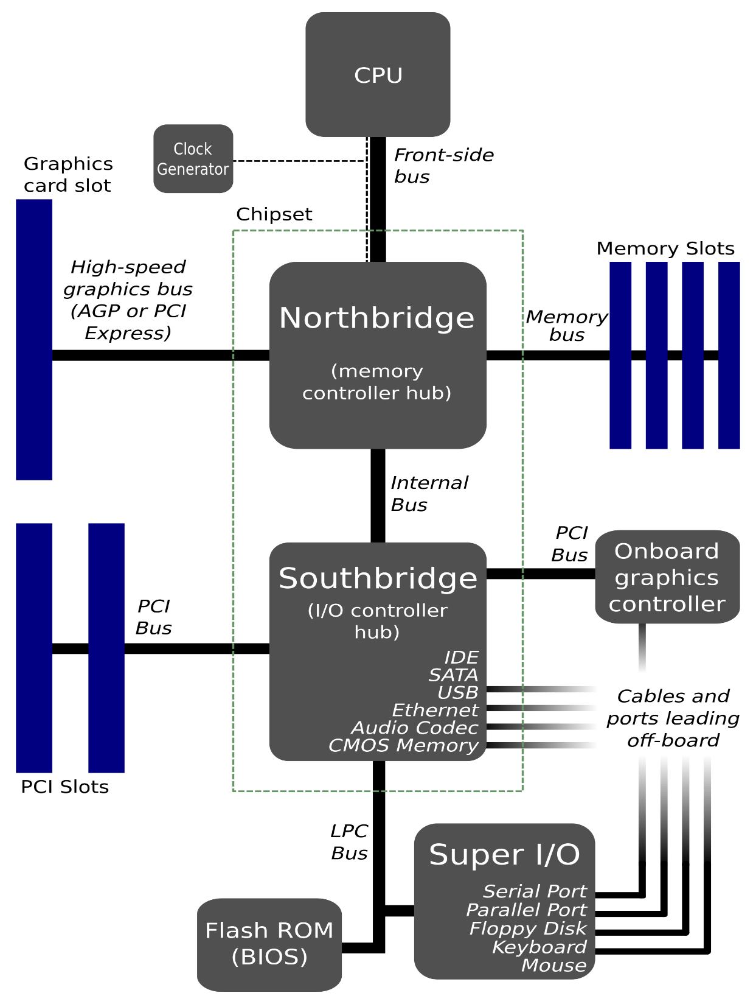
by Y.Wang 2007

Slide 13
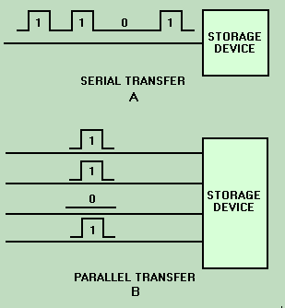
Parallel Transfer
Each bit of value transmit over one individual line.
8 data lines plus clock and control lines
Bus system, LPT port, EPP etc.
Cons: All Lines need to be synchronised; Crosstalk causes noise problem; Limited length
by Y.Wang 2007

Slide 14
Serial Transfer
A byte is transmitted bit by bit from one end to another.
Asynchronised transfer mode, two end need to be set on same clock rate.
More complicated protocol and hardware/software control than parallel transfer mode.
Universal asynchronous receiver/transmitter (UART using RS232), USB , FireWire, MIDI port etc.
by Y.Wang 2007

Slide 15
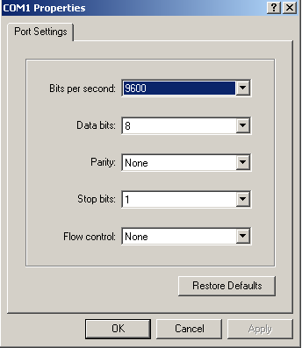
Example of RS-232 Protocol
Baud rate varied typical 9600
You can also set:
  Data bits
  Parity check
  Stop Bits
  Flow Control
by Y.Wang 2007
Notes:
MIDI: 31,250 bps
One start bit (must be 0), eight data bits, no parity bit and one stop bit (must be 1) is used.

Slide 16
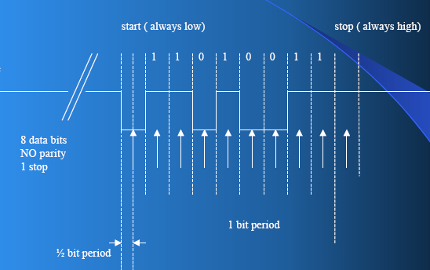
Transmit data in Serial Link
Setting: 8bits data, no parity bit, 9600 baud rate, start bit “0”, stop bit “1”, transmit LSB to MSB. “11001011”
by Y.Wang 2007
Notes:
Setting: 8bits data, no parity bit, 9600 baud rate, start bit “0”, stop bit “1”, transmit LSB to MSB. “11001011”

Slide 17
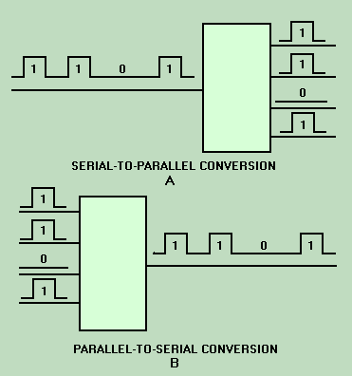
Conversion between Serial and Parallel transfer
by Y.Wang 2016
Notes:
http://www.tpub.com/neets/book13/55j.htm

Slide 18
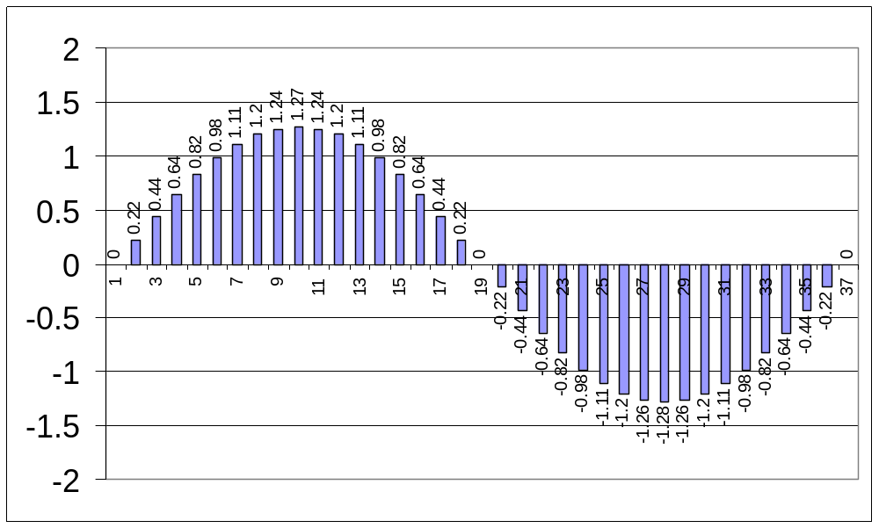
Digital Representation of analogue Signal
by Y.Wang 2007
Notes:
http://www.dutchaudioclassics.nl/The-basics-of-digital-audio-on-disc-Philips-1984/

Slide 19
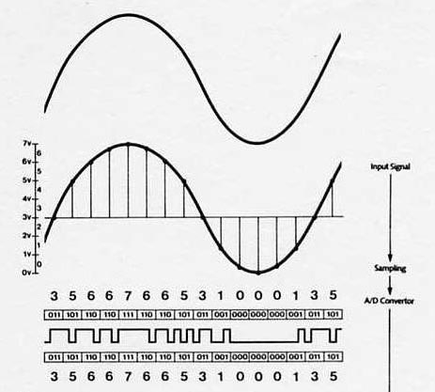
From analogue to binary
by Y.Wang 2016

Slide 20
Example of Compact Disc
Compact Disc Digital Audio Format:
Sampling Rate: 44.1 kHz
16-bit samples
2-channel stereo
Data transfer rate = 2×16×44,100
= 1.4112 Mbits/s
1 hour of music
= 605 MB
by Y.Wang 2007

Slide 21
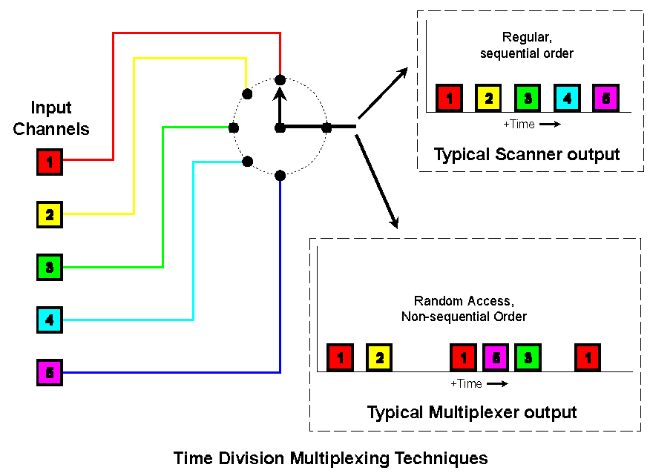
Time Division Multiplexing Channels
by Y.Wang 2007
Notes:
Extremely useful when you do multi channel device design.

Slide 22
Example T1 – Digital Signal 1
Digital Telecommunication standard to transmit voice and data.
24 voice channels in one line.
8000Hz sample rate (4KHz sound)
8 bits sound quality.
Every 24 channel add one bit control bit.
( 8 x 24 +1) x 8000
1.544 mbps is real speed.
by Y.Wang 2007

Slide 23
Some terminology
Bandwidth (networking)
  In computer networking and computer science, bandwidth, network bandwidth, data bandwidth, or digital bandwidth is a measurement of bit-rate of available or consumed data communication resources expressed in bits per second or multiples of it (bit/s, kbit/s, Mbit/s, Gbit/s, etc.).
  Example such as Gigabits Ethernet, or 54Megabit Wi-Fi connection.
by Y.Wang 2007

Slide 24
Network Throughput
The actual data transmission rate between two network terminals (e.g. computers) within the available bandwidth.
by Y.Wang 2007
Notes:
http://www.networkworld.com/article/2274805/lan-wan/chapter-4--passthrough.html

Slide 25
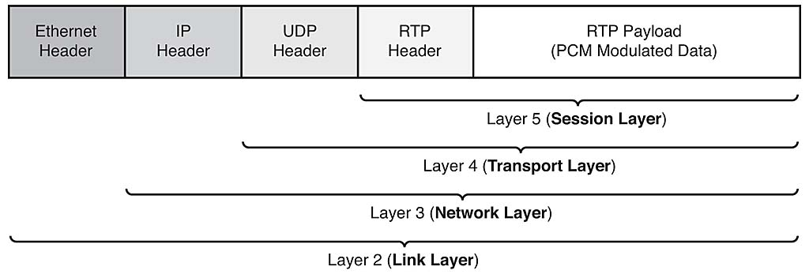
Transmission Payload
Payload in computing (sometimes referred to as the actual or body data) is the cargo of a data transmission. It is the part of the transmitted data which is the fundamental purpose of the transmission.
by Y.Wang 2007

Slide 26
The End
Questions?
by Y.Wang 2007

